Slide 1



COPIS
Training for Customs Officers
This project is funded by
the European Union
Gyula Almasi
Chisinau, February 2018

Slide 2
COPIS OVERVIEW
  The COPIS Business Objectives
  Connectivity (CCN Gateway, direct connection)
  Navigation (main menu, user guide, language)
  Terminology

Slide 3
COPIS OVERVIEW
COPIS Business Objectives
The Anti-Counterfeit and Anti-Piracy System (COPIS) is an application to protect Intellectual Property Rights (IPRS)in the European Union.

Slide 4
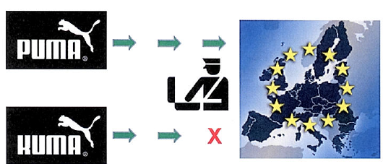
COPIS OVERVIEW
COPIS Business Objectives

Slide 5
COPIS OVERVIEW
COPIS Business Objectives
The purpose of the COPIS system is:
  to hold and manage a single repository of all Member States’ (MS) Applications for Action (AFAs) that protect the IPR of certain goods
  to contain all Infringements (INFs) – actions taken by CO when counterfeit goods related to those AFAs are detected

Slide 6
COPIS OVERVIEW
COPIS Business Objectives
The COPIS AFAs are divided into NAFAs and UAFAs:
  NAFAs (National), where goods are nationally protected and
  UAFAs (Union), where right holder wishes the Customs Authorities of several MSs to take action in connection regarding Union-wide property rights; UAFAs are exchanged between the involved MSs

Slide 7
COPIS OVERVIEW
COPIS Business Objectives
The central repository will be accessible by all the MSs, either using the COPIS UI or using the System-to-System interface
The confidential information in the AFAs will only be visible by the involved MSs

Slide 8
COPIS OVERVIEW
  The COPIS Business Objectives
  Connectivity (CCN Gateway, direct connection)
  Navigation (main menu, user guide, language)
  Terminology

Slide 9
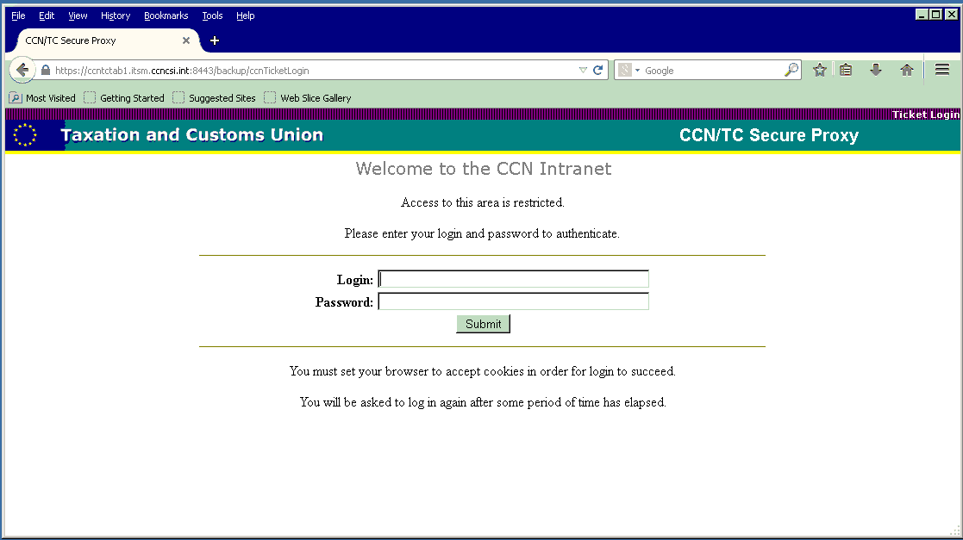
COPIS OVERVIEW
Connectivity and Login
Logging to the system:
  For the Member States user via a CCN Gateway
  For the Commission users via the application server

Slide 10
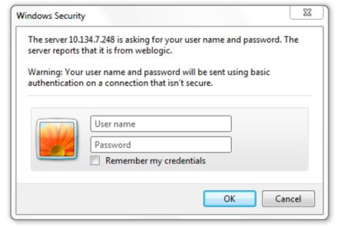
COPIS OVERVIEW
Connectivity and Login
Direct Connection

Slide 11
COPIS OVERVIEW
  The COPIS Business Objectives
  Connectivity (CCN Gateway, direct connection)
  Navigation (main menu, user guide, language)
  Terminology

Slide 12
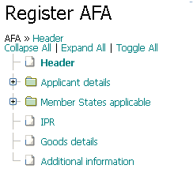
COPIS OVERVIEW
Navigation – Navigation Tree
Breadcrumbs for quick navigation:
  Collapse All: close all branches
  Expand All: opens all branches
  Toggle All: opens closed branches
  and closes open
  branches
Tree View: easily navigation through the different parts of the AFA record

Slide 13
COPIS OVERVIEW
Navigation –Data edition
Save for later use - Save the data without publishing to the central system, while basic set of control is performed (but not all). Data is stored with personal drafts
Publish – Saves the data to the central system and makes it available to other users. Full set of control is performed (more complete business rules application to the data entered is done before accepting the AFA)
Cancel - Exits from a page without saving data

Slide 14
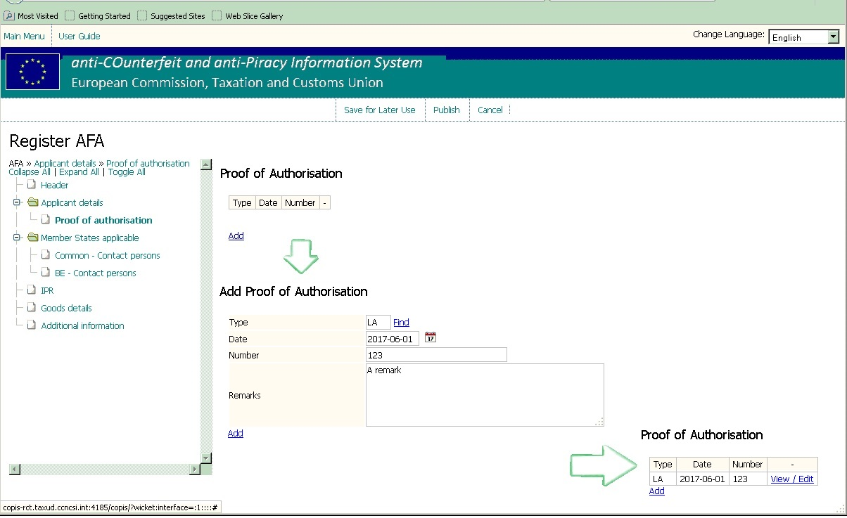
Navigation – Editing options
3 usages of “Add”
Add new entry to a list
Fill out data and click “Add” to save the entry
Proof of Authorisation added

Slide 15
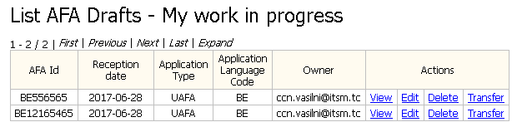
Navigation – Data browser
View: can be used to view a draft
Edit: can be used to edit the content of a draft
Delete: can be used to delete a draft
Transfer: can transfer drafts between users of the same MS

Slide 16
COPIS OVERVIEW
  The COPIS business objectives
  Connectivity (CCN Gateway, direct connection)
  Navigation (main menu, user guide, language)
  Terminology

Slide 17
Terminology
Term | Short | Description
Anti-COunterfeit and anti- PIracy System | COPIS | The system that is presented in this training
Application For Action | AFA | An application means a request to the customs authorities by an applicant to take action where goods are suspected of infringing property right
Intellectual Property Rights | IPR | The rights are granted to an individual/company, for a certain sign, invention, etc. (sometimes in relation to certain goods only) that were invented or created by that individual/company
Infringement | INF | A violation of the IPRs that are protected and for which an AFA is granted
Prefilled Application For Action | PreAFA | An application that is created in EDB system in order to request AFA creation based on the prefilled data

Slide 18
Terminology
Term | Description
Reject | An AFA is rejected when it is processed by the competent customs department with a negative result. Reason for rejection must always be given
Extend | The period during which customs take action on an AFA (expiry date) can be extended upon request of the applicant
Refuse Extension | Further extension of the period during which customs will take action can be refused by the competent customs department. This means that the AFA will expire on the expiry date. Reasons on the decision have to be given
Suspend | If an applicant does not fulfill his obligations, the competent customs department can suspend his AFA. During the period that the AFA is suspended, the customs authorities will not take any action on the goods and rights included in that AFA for their country. As soon as the applicant fulfils his obligations the suspension can be stopped and action can be taken again

Slide 19
PreAFA Management
What is a pre-AFA?
Besides registering an AFA, it is possible to electronically submit an AFA from the relevant information stored in EUIPO. Therefore, a Pre-AFA is automatically generated by EUIPO and sent to COPIS;

Slide 20
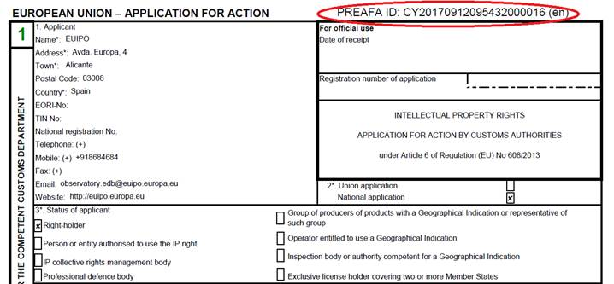
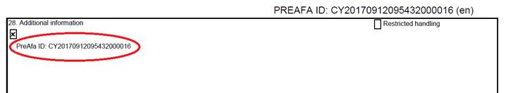
PreAFA
APPLICATION FOR ACTION example

Slide 21
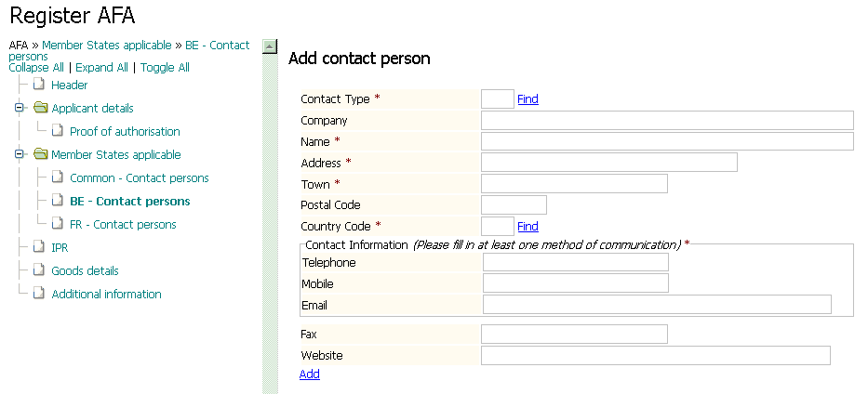
AFA MANAGEMENT

Slide 22
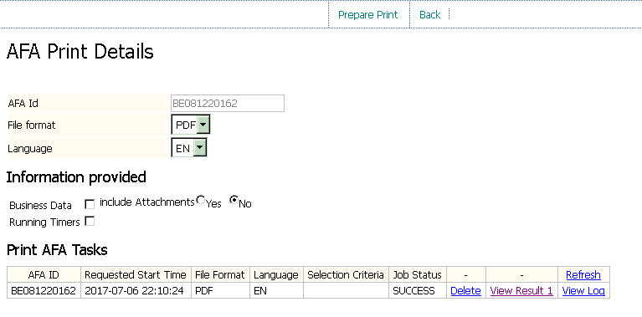
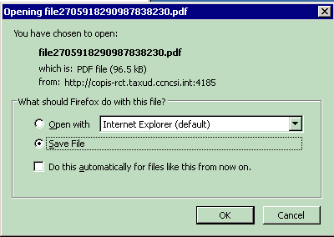
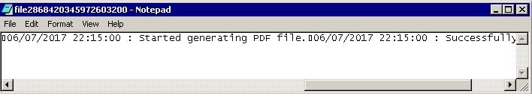
AFA ACTIONS
AFA Print Details

Slide 23
INFRINGEMENT MANAGEMENT

Slide 24
INFRINGEMENT MANAGEMENT
What an Infringement is?
  The IPR of certain goods can be protected by an AFA that is available to all Customs Offices
  A Customs Office that receive such AFA may suspend or detain goods if they are suspected of infringing an IPR
  In this case, an Infringement is registered in COPIS when the counterfeit is detected, including the actions that the CO takes
  The COPIS Infringement can be based on AFA but can also be Ex-Officio (in this specific case AFA will come on a later date)

Slide 25
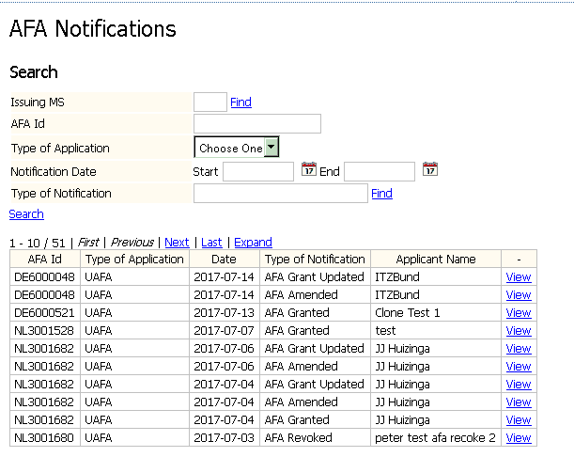
NOTIFICATION AND EVENT MANAGEMENT
Select:
Issuing MS
AFA Id
Type of Application
Notification Date
Type of Notification
View AFA record

Slide 26
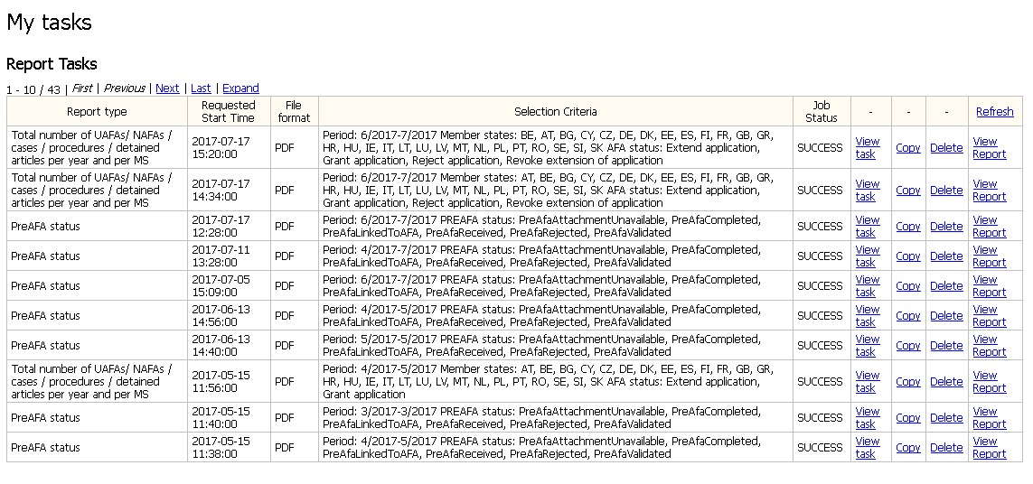
PRODUCE STATISTICS REPORT

Slide 27

Questions

Slide 28
Thank you very much for attention!

Slide 29

Coffee break

