Slide 1



Introducere în proprietatea intelectuală
This project is funded by
the European Union
Kenny Wright.
Chisinau, februarie 2018

Slide 2
Proprietatea Intelectuală
Proprietatea Intelectualăpe scurt
și cum este protejată

Slide 3
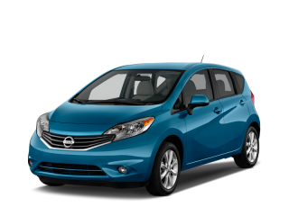
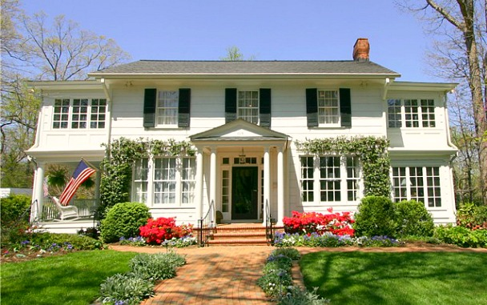
Proprietatea Intelectuală
Proprietate
Tangibil
Tangibil
Intelectuală

Slide 4
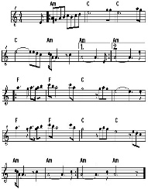

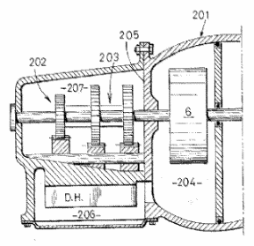
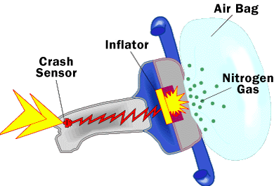


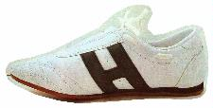
Proprietatea Intelectuală
Drept legal
Pentru ce?
Cum?
Drepturi de autor
Forme creative sau artistice originale
Exista automat
Brevete de invenție
Noile invenții
Cerere și înregistrare
Mărci înregistrate
Identificarea distinctă a bunurilor sau serviciilor
Înregistrare
Proiecte industriale
Aspect exterior
Înregistrare
Notes:
IP rights can divided in different categories, according to the type of innovation or creation that is the object of protection.
Patents: Only inventions can be patented and they will be disclosed to the public. The patent office will examine the patent application to determine whether the stringent requirements for a patent grant are met.
Copyright: Copyright includes, for example, literature, art, drama, music, photographs, recordings, broadcasts, etc.
Trade marks: Trade marks are distinctive signs or indicators of the source of a product or service, e.g. names, logos, colours applied to the owner's products or services, which distinguish them from products or services provided by competitors.
Registered designs: Registered designs protect the external appearance of a product. They do not give any protection for technical aspects. They include new patterns, ornaments and shapes. To be officially registered, designs need to be original and distinctive. The artistic aspects of a design may also be protected by copyright.
*Unregistered designs also enjoy some protection. An unregistered design is a free, automatic right that you get when you present a design to the public. It gives you the right to stop anyone from copying your design but typically the protection afforded by an unregistered design is of more limited duration than that available for a registered design.
Trade secrets: This is an alternative to patents. Trade secrets cover information not known to the public. If the possessor of such information is careful to keep the information confidential (e.g. by signing non-disclosure agreements with employees/partners) he can sue anyone who steals it. However, trade secrets offer no protection against reverse-engineering or against competitors who independently make the same invention.

Slide 5
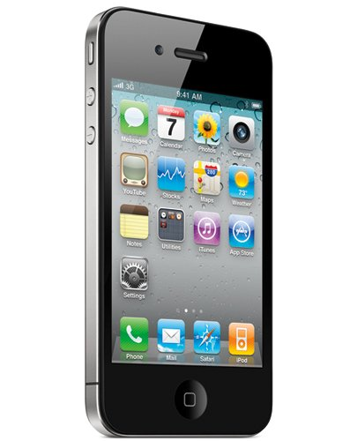

Proprietatea Intelectuală
Drepturi de autor Software-ul.
Brevet de invenții Ecran tactil.
Marcă comercială
Marcă comercială Sunet de pornire.
Design industrial Forma telefonului.

Slide 6
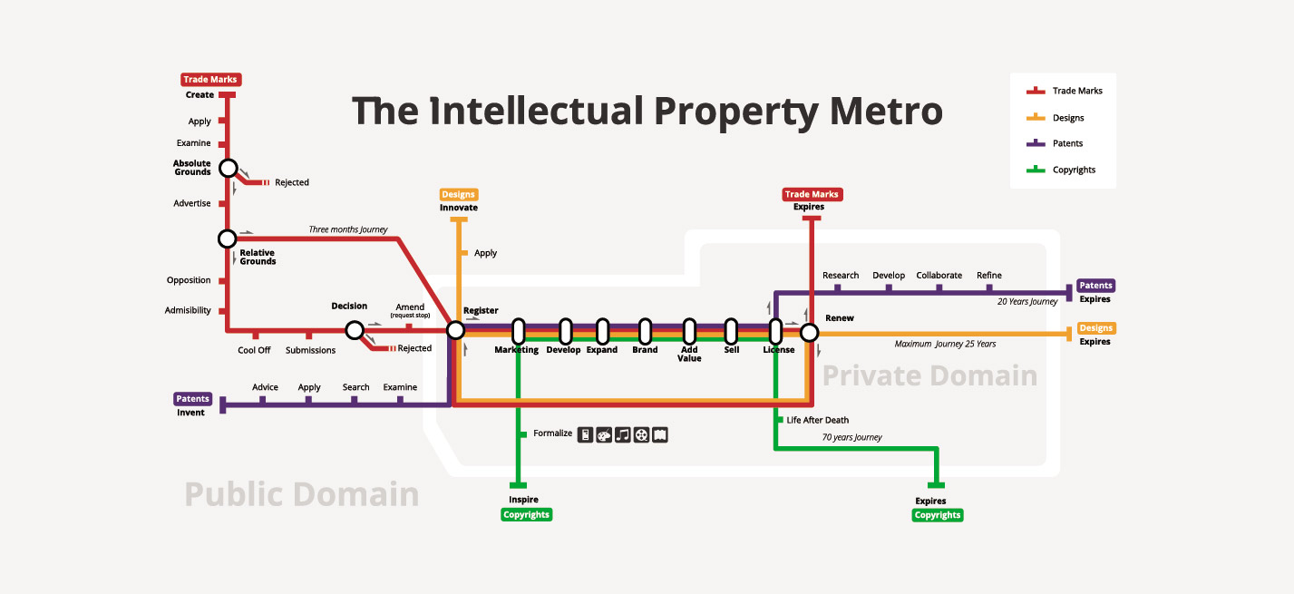
Novelty and Individual Character

Slide 7




Proprietatea Intelectuală
Protecție Națională -
Protecție Regională -
Protecție Regională -
Protecție Globală -

Slide 8
Introducere în proprietatea intelectuală
Kenny Wright.
Suport pentru asigurarea respectării
drepturilor de proprietate intelectuală.
Chisinau, februarie 2018.

